Slide 1

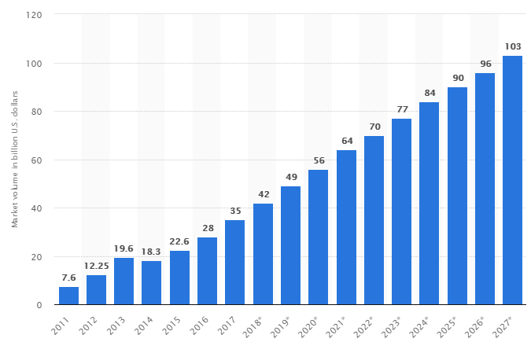
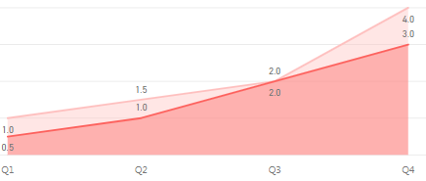
GS1 Canada Data Warehouse Project
1. Background and Purpose
4. Action Plan
According to Statista, the revenue of the Big Data industry will increase to 103 billion US dollars in size by 2027. With the current industry climate, GS1 Canada wants to build a “Data Warehouse”. Through successfully building D/W, GS1 Canada will obtain user experience about products, new revenue opportunities, and foundation to build “Big Data”.
# | Type | Issue | Role | Date
1 | Infra | Support technology (MongoDB/ETL tool/Business Intelligence tool) | System Architect | Jan ~
2 |  | Build GS1 Canada Data Marketplace (CMS) | System Architect | Feb
3 |  | Define prototype | System Architect | Feb
4 | Data | Define the report data and Visual Diagram | Data distributors (Sales/marketing/Finance/Executives … ) | Feb ~
5 | Training | Create Training module (Video/Mobile) with PowerApps | System Architect | Mar ~
6 | Guide | - Migration Procedure - Data Mapping Chart - Standard Operating Procedure - Report (Statistics) Service Request Form - Report Visualization and IO definition Form - User/Developer guide for GS1 Canada Data Pool | System Architect | Jan ~
7 | Project | Plan/Do Data Mart Pilot project | SA/DB/BI team | Mar ~ Apr
[Global Big Data market size]
49 B
103 B
2019
2027 year
2. Progress and Current situation
GS1 Canada is:
- Understanding the importance of data utilization
- In the beginning stage of building Data Warehouse
- Preparing technical solutions with MongoDB (Storage)/Apach
NiFi(ETL)/Power BI/Contents Management System (CMS)
- Defining the prototype for “DATA MART”
5. Goal
6. Measures for Success
- Build D/W Tech Infrastructure
- Make Standard Operating Procedure (SOP)/Guides
- Raise participation rate by Quarter
[Weekly Avg Participate/Request count by a stakeholder]
- Is Infrastructure built
- Is GS1 Canada Data Share space built
- Is Standard Operating Procedure Prepared
- How many times stakeholders request BI Report work
- How many report pages are in GS1 Canada Data Pool
- What percent of BI report are used/reused
- How many stakeholders complete Training Module
3. Root-Cause Analysis:
[Comp. Business Intelligence Tools]
[Comp. Contents Management System
Quarter | Parcipate Count | Report Request
Q1 | 1 | 0.5
Q2 | 1.5 | 1
Q3 | 2 | 2
Q4 | 4 | 3
Type | Tableau | Power BI
Cost | Free version | Free version
Install | Need | Office 365
Good | Drill-down Visualization | Similar to Excel I/F
Bad | High cost for smaller Biz | Cannot share with Desktop
Type | WordPress | SharePoint
Cost | Open source | Microsoft
Tech | PHP/MySQL | C#/Nodejs
Install | Need | Office 365
Security | Need | Office 365
Utilize | Flexible | Strict
7. Purpose & Inquiry
- Each action plan needs another document in detail
E.G.: Data Mart Pilot project has different purpose,
duration from building Data Warehouse

Slide 2
GS1 Canada Data Marketplace
1. Background and Purpose
4. Action Plan
2. Progress and Current situation
5. Goal
6. Measure for Success
3. Root-Cause Analysis:
7. Purpose & Inquiry

Slide 3
GS1 Canada Data Mart Piot Project
1. Background and Purpose
4. Action Plan
2. Progress and Current situation
5. Goal
6. Measure for Success
3. Root-Cause Analysis:
7. Purpose & Inquiry

